Slide 1
Threats to Freshwater Fishes in Bangladesh

Slide 2
Fish species diversity in the open water is the integral part of inland capture fisheries production that has been limited by a variety of factors, including habitat loss as a result of agricultural intensification, urbanization, environmental degradation and pollution, the over exploitation of resources, and climate change. Fish production and diversity in natural water bodies is extremely sensitive to climatic changes because feeding, migration, breeding, and other biological activities are affected by a complex set of water quality and weather parameters.

Slide 3
Threats to Freshwater Fishes in Bangladesh
Habitat Loss:
-caused due to massive siltation for the erosion in the Himalayan areas;
-conversion of wetlands to agricultural lands;
-development interventions, like implementation of flood control projects, constructions of roads, expansion of human settlements, townships
-construction of embankments for the purpose of protection from tidal inundation and flood control and irrigation and other developmental infrastructures.

Slide 4
Present state of Kapotakhya River in Bangladesh

Slide 5
Over and Unplanned Exploitation:
-High demand and high price of fishes, coupled with country’s high unemployment situation resulted in putting increased efforts in fishing lead to over-exploitation.
Adoption of destructive fishing methods, practices, like use of small mesh size nets and monofilament gill nets, poisoning, dewatering of water bodies, etc. also cause fish decline.

Slide 6
Aquatic Pollution
Use of pesticides and fertilizers
Discharges from industries and municipal sewerage: The most polluted rivers in Bangladesh include the Buriganga, Turag, Shitalakkha, Balu, Meghna, Karnaphuli, Surma, Dhaleswari, etc.
It is observed that a number of drains have fallen into the river from both the banks. As a result various chemical wastages from agro-industrial sources fall through the drainage and sewerage systems and polluted the water quality consequently destroying the spawning, nursing and grazing grounds of fish species.

Slide 7
Untreated industrial effluents and municipal discharge

Slide 8
Introduction of Exotic Fish:
24 exotic fishes introduced in Bangladesh
Introduced or escaped fish may become established in natural ecosystems or habitats as an invasive alien species and thus could be an agent of ecological catastrophe.
Risks of the exotic fishes:
-Causes the loss of indigenous biodiversity.
-predation by the exotic species,
-changes and disruption in food chain,
-transmission of diseases,
-competition for food and shelter etc

Slide 9
Impact of Climate Change on Freshwater Fishes
Floods or exceptionally large seasonal pulses and droughts or prolonged dry spells can cause population declines, reduced abundance and altered species composition.
Erratic rainfall was discovered to be a primary climatic component that was linked to a reduction in fish species diversity.
Small increases in temperature may be sufficient to have sub lethal effects on tropical fish physiology and reproduction.
Salinity intrusion in inland water

Slide 10
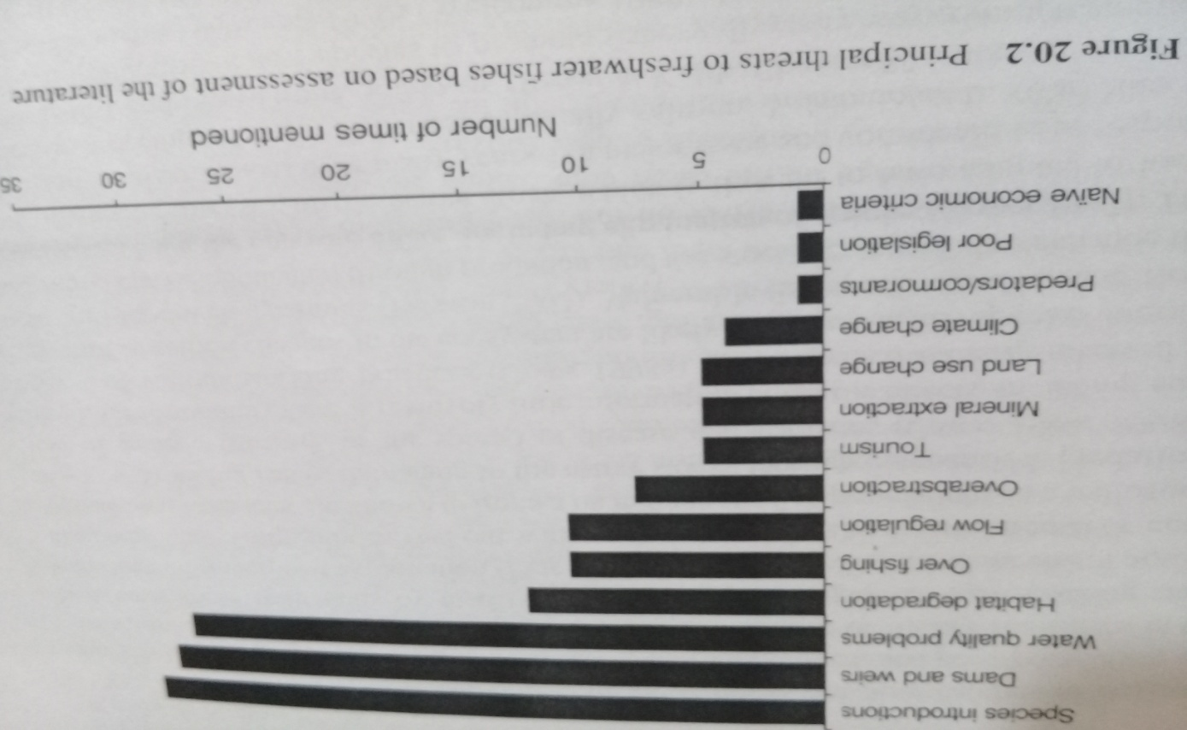

Slide 11
Change of natural habitats
Due to natural causes like shrinkage of genetic base and manmade causes like water pollution through industrial wastage, sewerage wastage, agricultural wastage, destroyed the spawning, nursing and grazing grounds of fish species of the river.
Construction of Barrage and water diversion
Construction of the Barrage and diversion canal at the upstream caused major detrimental catastrophe for the ecosystem of the river. The migratory route of different fishes has largely been affected for this reason.
Excessive use of river water for irrigation purpose
Excessive use of river water and reclamation of land for agricultural purpose (irrigation) resulted shrinkage of spawning and feeding grounds for fish species.

Slide 12
Siltation due to less water flow
Siltation at the upstream of the river was a serious threat that caused reduction of water flow and as a result spawning and nursing grounds of many fishes have been drastically affected in recent years.
Construction of sluice gate
These constructions adversely affect on fisheries diversity and livelihood of the adjacent fishermen.
The construction of sluice gates causes siltation in the river bed which influences the water flow consequently affecting the entire ecosystem.

Slide 13
The fisheries resources of Bangladesh is being deteriorated day by day due to-
Over fishing,
catching of juvenile and brood fishes by using illegal fishing gears,
katha fishing in water bodies,
use of illegal/destructive fishing gears (current jal),
fishing by dewatering,
low water depth in winter,
abstraction of water for irrigation,
the capture of fish fry and brood fishes.
indiscriminate use of chemical fertilizer and insecticides/ pesticides
destruction of natural breeding grounds and feeding grounds,
harvesting of wild brood fishes
uncontrolled fishing
poor implementation of fish acts and poor/or lack of management practices in the country.
ultimately affect the survival and existence of the fish fauna and resulting the declination of fish diversity.

